Slide 1
Proposing a Certain Dynamic Priority Queue Worker in OpenFaaS Platform
Presenter: Shengyu Chen, Bangyan Li

Slide 2
Outline
Problem Statement
Question Analysis and Demand Analysis
Algorithm Design
OpenFaaS Gateway Functionality
Two Different Methods’ Implementation/Extension
Current Process

Slide 3
Problem Statement
Motivation:
Platform using in industries, need to deal with a lot of things. Platform cannot complete received requests in the order of time directly, because everything has priorities.
We need to prioritize the most important and urgent matters, and put the less urgent matters behind.
Solve potential unfair scheduling phenomena. Hopefully improve the overall throughput and responsiveness of the system.
Novelty:
There is no detail priority queueing mechanism in OpenFaaS Gateway, to make queue sorted by priority
After searching, only few related work about that.

Slide 4
Problem Statement
Project Goal:
Initial Goal: define a certain priority queue worker to satisfy certain demand
Ultimate Goal: design a dynamic priority queue worker, reference list will update within a certain time.

Slide 5
Question/Demand Analysis
Question Analysis:
How does the OpenFaaS serverless platform works?
How does the OpenFaaS serverless platform handle priority?
Does the OpenFaaS contain a reference priority list?
Expect for OpenFaaS, how does other serverless platform make money?
Demand for Priority:
OpenFaaS Platform need a priority list(certain or dynamic) – Platform’s Priority
Take special users’ demands into consideration(pay more tokens)-Benefit Priority
Time priority

Slide 6
Algorithm Design
Initialize/Randomize function priority list
Receive the requests within a period and put it in queue(order by time)
Refer function priority list, re-order the received requests in queue
Check benefit priority(tokens) in each requests and move up/down priority level in queue -- sort it again.
Copy the re-order list to new list1 and clear up this re-order list
Pop up the requests from new list1 by order to next steps’ function execution.
Conditional: Update function priority list within a certain period(Make priority queue dynamic):
LRU and LFU
Go back the the step two

Slide 7
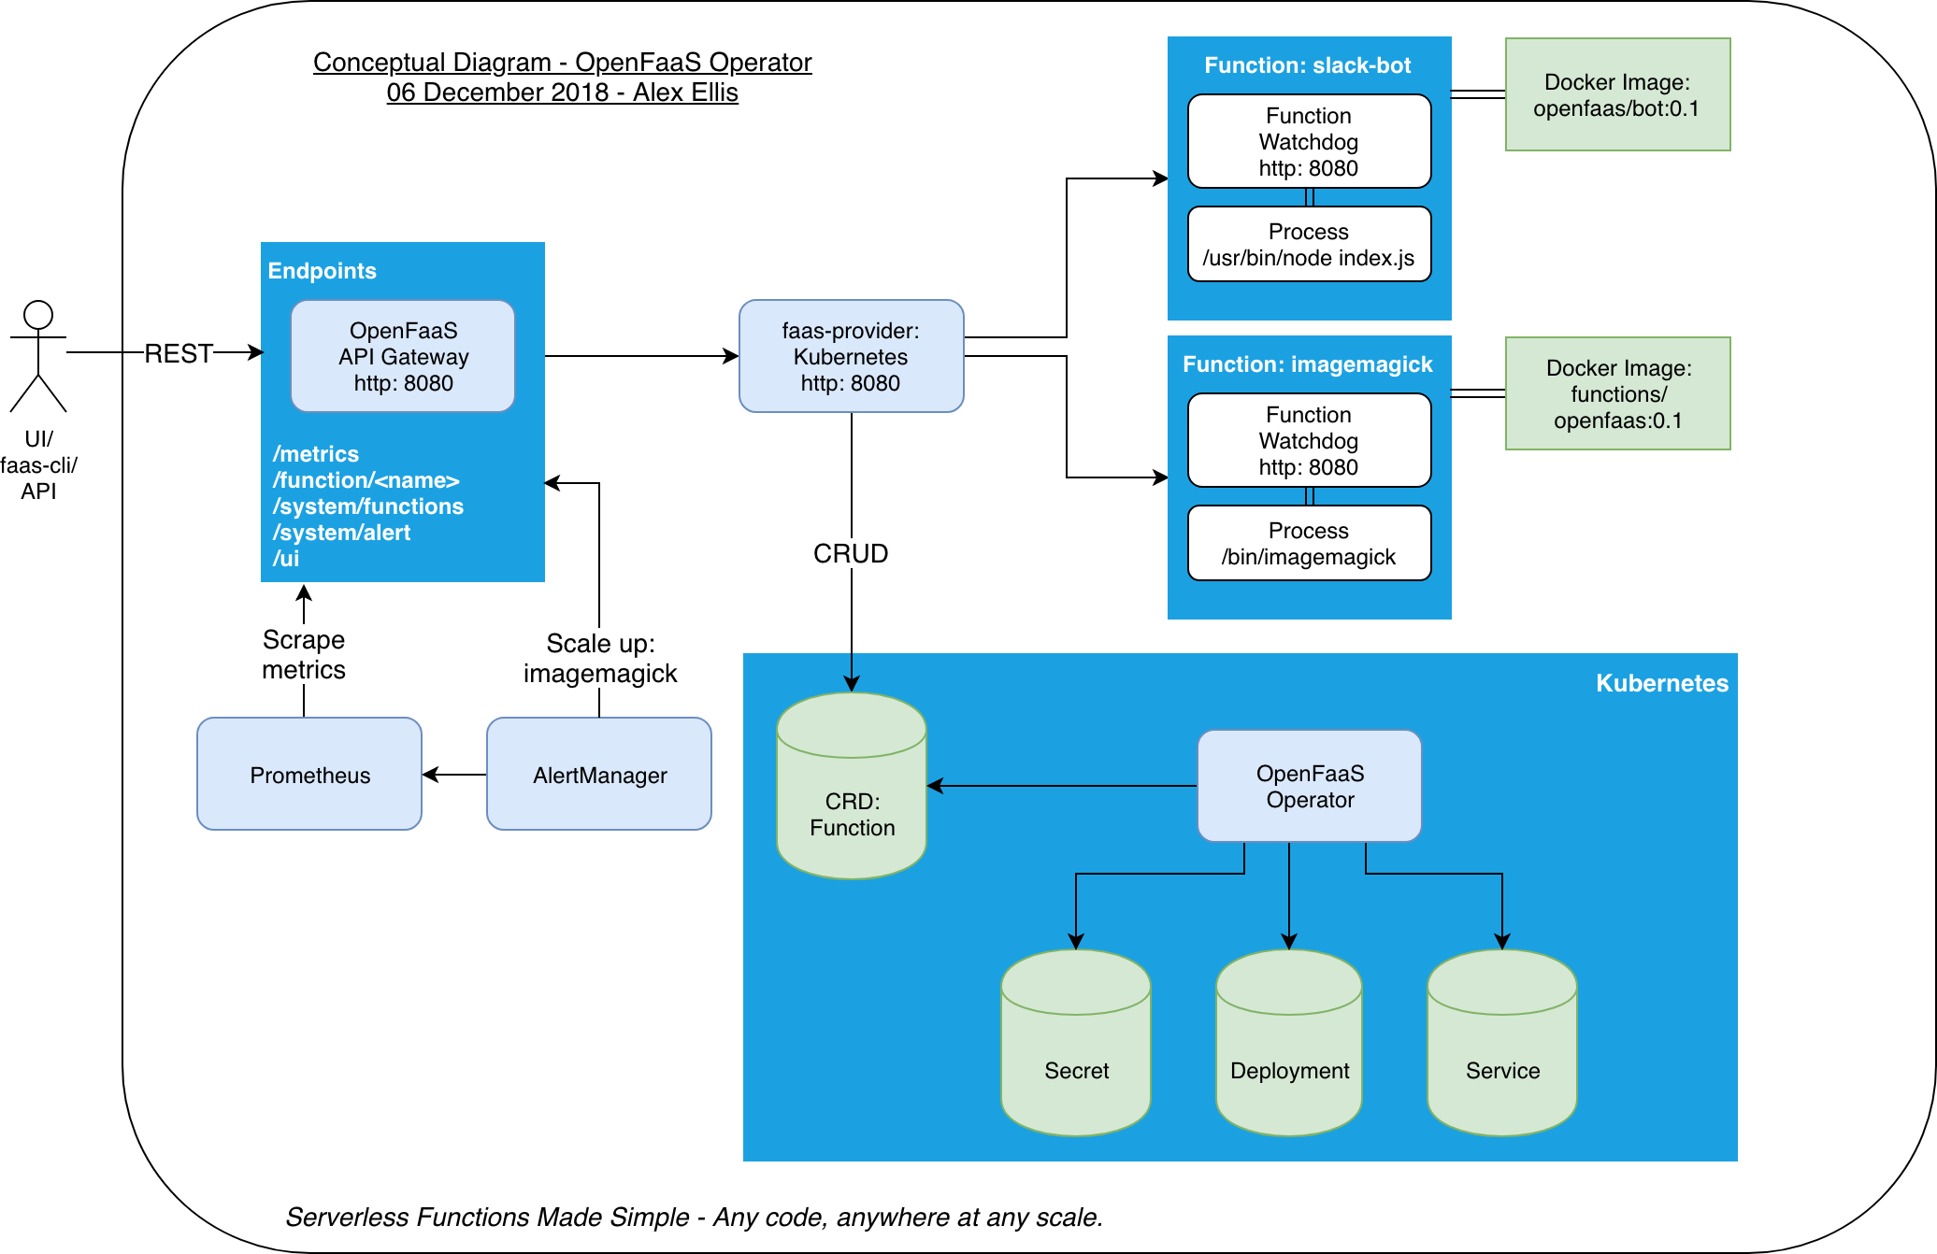
OpenFaaS Gateway Structure
Structure Statement:
When launch the OpenFaaS, initialize a Nats-queue.
OpenFaaS will subscribe queue information.
When new request arrived, publish it in Nats-Queue
OpenFaaS will get the request and put into the buffered channel
OpenFaaS will execute the request/function from buffered channel by order

Slide 8
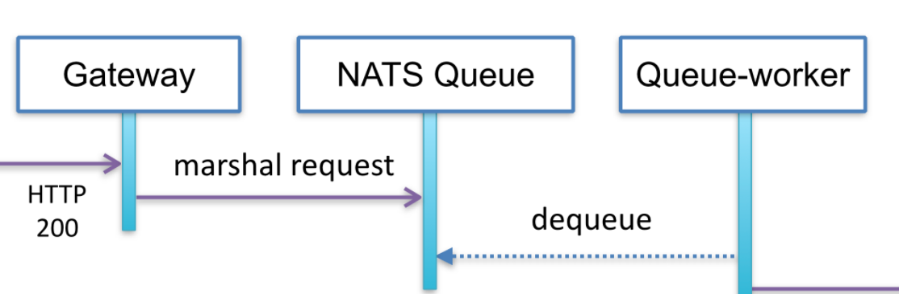
Two Different Methods Description
Priority Handler in middleware before OpenFaaS Gateway
Limitation: Connection Latency when users connect to platform
Modify the priority in message processing step after request subscription
Limitation: Execution Latency in OpenFaaS platform(Priority Sorting)
Function Execution
Request
Middle ware

Slide 9
Current Process and Problems
Current Process:
Done first methods design:
Implemented in Python
Second method still in process.
Done the first draft report
Docker Problem:
Hard to modify the default docker file(.yml) in source code. Because it directly pull openFaaS image from dockerhub.
Currently, we tried to modify the source code locally and build the docker image, push it into our dockerhub, finally achieve new OpenFaaS deployment in docker.
Platform Problem:
Platform execution is very slow in specific functions on local OS system.(maybe computer problem)

Slide 10
Next Step work: Performance Analysis
Continue work on Method 2
Optimize Method 1’s algorithm and evaluate the performance
Evaluation:
Time/energy consumption
Latency
Fairness
Functionality
Finish the final report from first draft

Slide 11
Thank you

